Slide 1
G.L.A.P.S
Geographic Location Attribute
Predictor System

Slide 2
Team
Front End
-Brian Schweikart
- Jesse Watts
Back End
-Mallory Milstead
-Gabriela Canjura

Slide 3
The problem
How will new structures or facilities effect property values in an area?
As a home owner would it be beneficial or detrimental to my property values to have a particular facility built in my area?
As a city or town how will this effect our constituents?

Slide 4
GLAPS
Goal:
Our software will aim to predict the effects of these facilities on future home values.
The user will enter an address and current home value, then select the type of facility and the number of years in the future for which they wish to view the predicted property value.
Minimum Viable Product:
Our software will be able to predict future values of houses based on the current factors in a specific county.

Slide 5
Data Collection
Our data was obtained by using the Census API
Visualization of the Data was achieved through the use of Google Facets.
https://pair-code.github.io/facets/

Slide 6
Software
Language:
- Python
Database:
- Sqlite
Machine Learning:
- Keras backed with TensorFlow
Visualization:
- TensorBoard

Slide 7
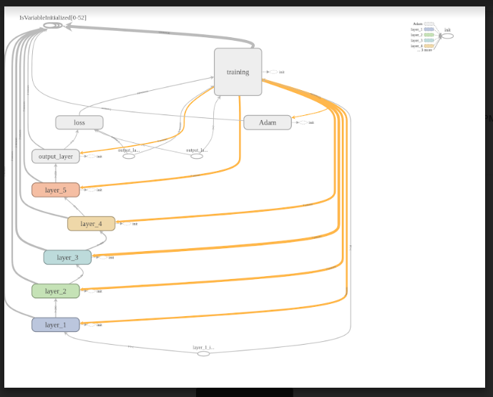
TensorBoard Model

Slide 8
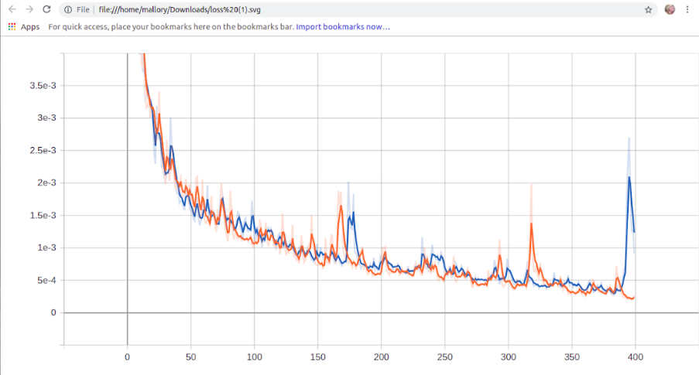
TensorBoard Runs

Slide 9
Going Forward
Switching from current home value predictions to future home value predictions

